Slide 1
How to Personalize Student Professional Development at Scale
04.15.2021

Slide 2
Introductions
David Motherbaugh
Associate Dean
Undergraduate and International
Culverhouse College of Business
University of Alabama
Sean Carson
Vice President
University Partnerships
Suitable

Slide 3
Culverhouse College of Business
8,528 undergraduate students
603 graduate students
U.S. News & World Report Ranked 44th in the nation
U.S. News & World Report Ranked 28th among public business schools
Manderson Graduate School of Business MBA ranks 22nd among public universities

Slide 4
Agenda
Life before UA Business LEAD
Why make a change?
Why technology was necessary
Bridging academics and professional development
Identifying Professional Competencies
Implementing LEAD: Crawl, Walk, Run
How UA Business LEAD impacted Culverhouse
UA Business LEAD app tour
FREE GIVEAWAY – Branded app
Strategies for successful student adoption
Questions

Slide 5
Learning outcomes for this session
Have tangible solutions to incorporate technology within your student professional development
Implement a competency based framework for your student professional development program
Consider a more intentional approach to your out-of-class experience

Slide 6
A lot of great co-curricular activities happening but…
Life at Culverhouse before UA Business LEAD
No scalable tracking system
Not competency driven
No consistent touch points

Slide 7
POLL
How is your business school using technology to track professional development?

Slide 8
Why make a change?
Culverhouse wanted to be competency driven
Corporate feedback showed gaps in professional competencies
Wanted to implement ePortfolios as a High Impact Practice
Using paper passports for career competencies

Slide 9
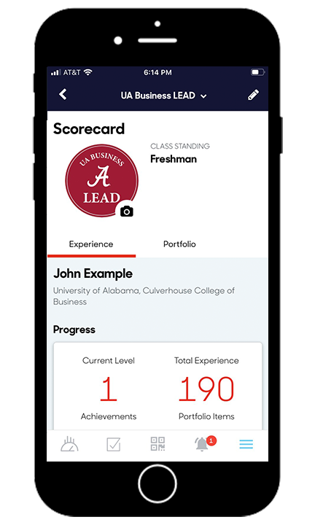
Why was technology necessary?
Scalable tracking
Student ePortfolios
Program assessment
Recruiter relations

Slide 10
POLL
How is your business school using competencies to unify programming?

Slide 11
Bridging Academics and Professional Development
PROFESSIONAL
DEVELOPMENT
ACADEMICS

Slide 12
Identifying UA Business LEAD Competencies
AACSB AoL Goals | UA Business LEAD Competencies
Goal 1: Strategic Problem Solving | Self-Awareness and Leadership Critical Thinking, Problem Solving, and Ethics
Goal 2: Quantitative Literacy | Personal Financial Literacy Digital Technology
Goal 3: Global Perspective and DEI | Global and Cultural Engagement Diversity, Equity and Inclusion
Goal 4: Professional Proficiency | Teamwork and Collaboration Career and Professional Development UA Business Engagement
Goal 5: Effective Communication | Communication Skills

Slide 13
UA Business LEAD: Crawl, Walk, Run
Suitable
Soft Launch
Pilot
FR Compass
(1,500 students)
College
Required
Paper
Passport
The
Future
2017-18 AY
2018-19 AY
2019-20 AY
2020-21 AY
2021+

Slide 14
How UA Business LEAD impacted Culverhouse
90% of freshman and 48% of all students engaged this year
Orienting entire college around a core set of competencies
Integrating curricular and co-curricular
Building a student culture of engagement and professional acuity
Providing consistent touch points for student engagement
Helping to identify intervention opportunities for retention
Growing interest and buy-in from faculty and recruiters
MBA program adopted Suitable

Slide 15
Tour of UA Business LEAD

Slide 16
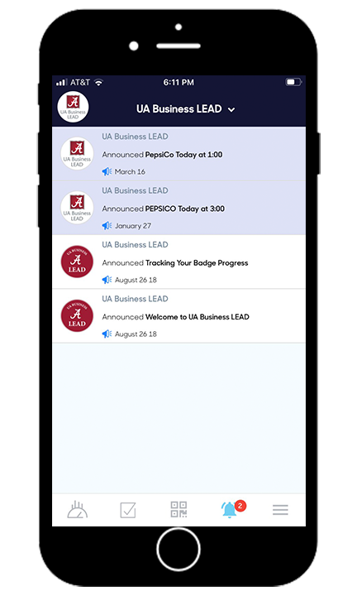
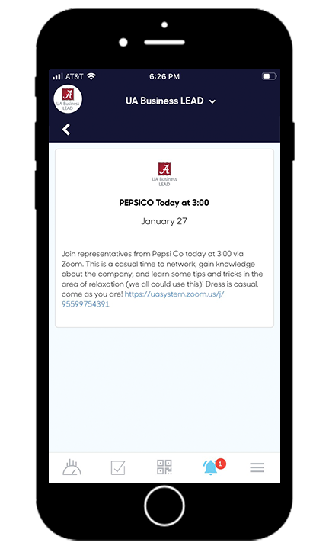
Mobile Scorecard and Push Notifications

Slide 17
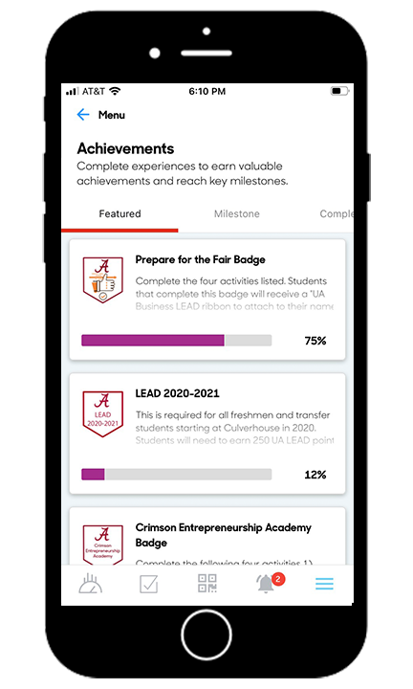
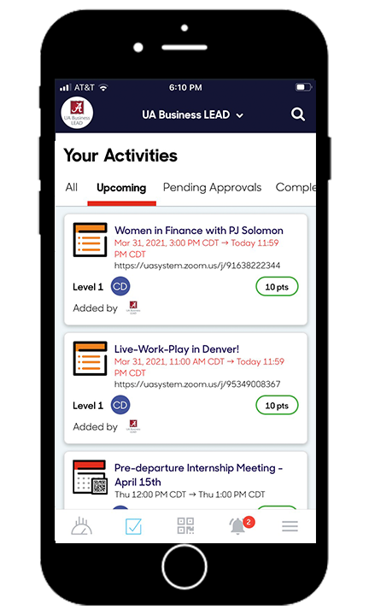
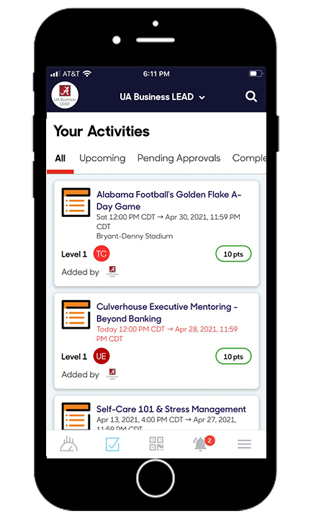
Achievements and Upcoming Events

Slide 18
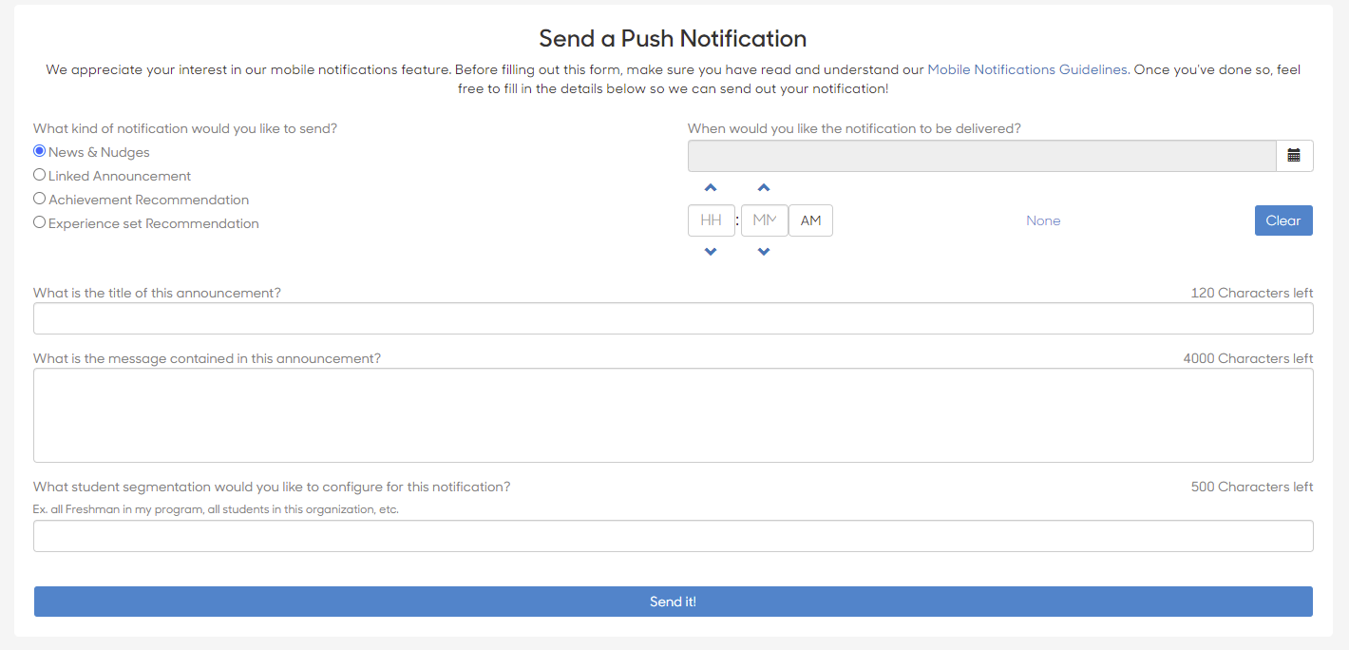
Student Communication Capabilities

Slide 19
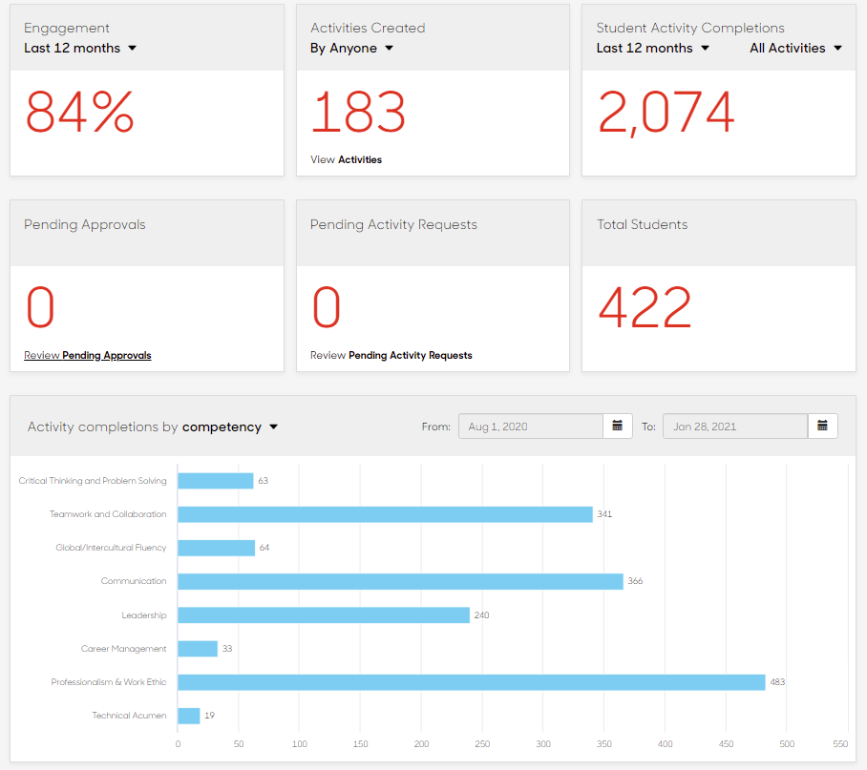
Real Time Engagement Analytics

Slide 20
FREE GIVEAWAY – Branded app
Comment “App” in the chat
for a branded app to test

Slide 21
Strategies for Successful Student Adoption
Start with a smaller planning team
Create a brand that is personalized to your school
Develop a comprehensive awareness strategy
Student value proposition: Engagement = Development
Take advantage of momentum. Be ready to scale
Created Hype videos for your program
Create walk through video for student usage
Get buy-in for a faculty support pilot
Experience-based incentives are more effective
Create a student ambassador program
Employer buy-in can sell the value for you
Give students options to earn progress. Don't be too prescriptive.
Feature engaged students in your periodic newsletter
Team-based competitions add a social component

Slide 22
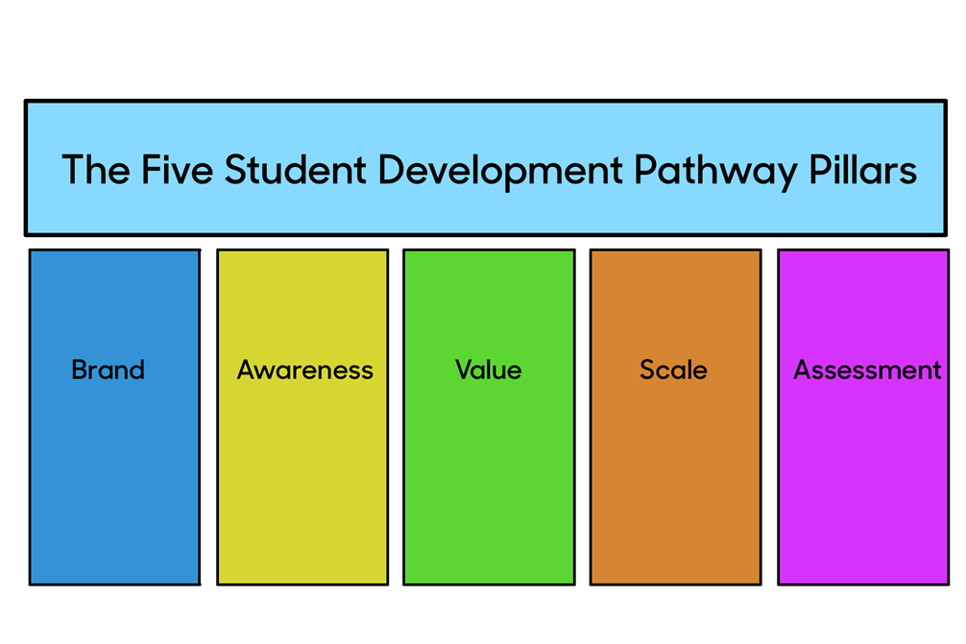
The five pillars of student development

Slide 23
POLL
What would you like next from Suitable?

Slide 24
Questions?

