Slide 1
Enhancing Experiential Learning and Competency Development using Technology
02.18.2021

Slide 2
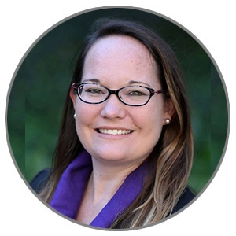
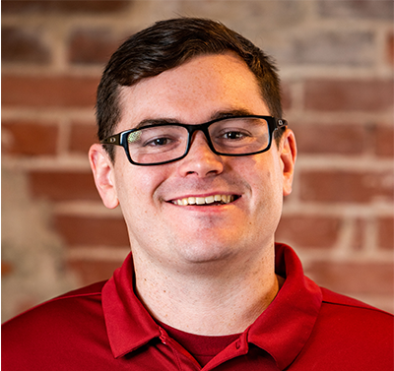
Introductions
Catherine Coe
Director of Online Programs and Enrollment Management
Warrington College of Business
University of Florida
Sean Carson
Vice President
University Partnerships
Suitable

Slide 3
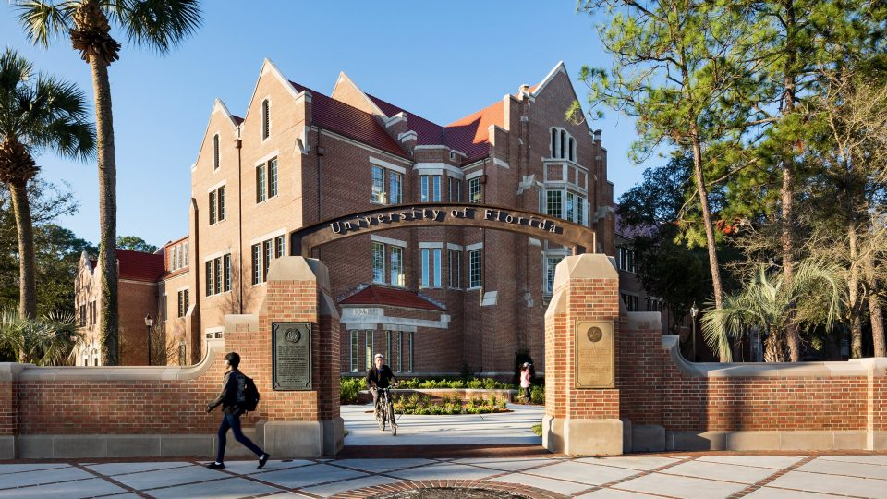
Heavener School of Business
Heavener offers bachelor’s degrees in Finance, General Business, Management, Information Systems & Operations Management, and Marketing
More than 4,500 students enrolled
U.S. News & World Report Number: 1 Online Business Bachelor Degree
50% of Heavener students graduate with an international experience
U.S. News & World Report Top 15 U.S. Publics: 2020 Best Undergraduate Business Programs

Slide 4
Agenda
Life before Gator Ready
Why make a change?
Why technology was necessary
Identifying Professional Competencies for Gator Ready
Bridging Student Engagement and Career Readiness
Personalizing the Student Experience
How Gator Ready impacted Heavener
Gator Ready app tour
Strategies for successful student adoption
Future Plans for Gator Ready
Questions

Slide 5
Learning outcomes for this session
Learn how to unify your student engagement and career readiness programming
Learn how to leverage technology in order to track your students’ co-curricular and experiential learning
Learn how to personalize and gamify your student experience to increase student engagement

Slide 6
Life at Heavener before Gator Ready
Numerous programs in place for students outside of the classroom
‘Student Engagement’ and ‘Career Development’ not connected
Student leaders were highly engaged
No formal approach to the assessment of competency development
No technology in place to track student participation
Struggled to engage the Middle 60% of students

Slide 7
POLL
How is your business school using technology to enhance experiential learning and competency development?

Slide 8
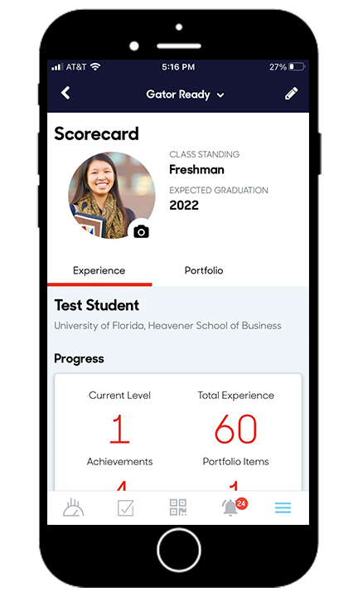
Why make a change?
Wanted to engage the Middle 60% in the Heavener experience
Wanted to adopt a competency-based career development approach
Employer demand for soft skills was evident
No umbrella for out-of-class learning to live
No way to assess the competencies that students were developing
No way for students to track their own competency development

Slide 9
Why was technology necessary?
Wanted to engage the Middle 60% in the Heavener experience
Wanted to adopt a competency-based career development approach
Employer demand for soft skills was evident
No umbrella for out-of-class learning to live
No way to assess the competencies that students were developing
No way for students to track their own competency development

Slide 10
POLL
How is your business school using competencies to unify programming?

Slide 11
Identifying Gator Ready Competencies
Combined Heavener Vision Statement with NACE Career Readiness Competencies

Slide 12
Bridging Student Engagement and Career Readiness
GATOR READY
STUDENT
ENGAGEMENT
CAREER READINESS

Slide 13
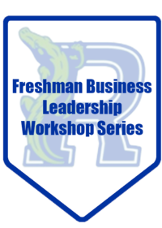
Personalizing the Student Experience
Student leadership pathway (top 20%)
Gator Ready pathway (middle 60%)
Program logo, branding and colors
Digital Badge Images
“Choose your own adventure” approach
Combination of both synchronous and asynchronous programming
i.e. Live Events vs. LinkedIn Learning Modules
Custom student groupings: Cohort, Major, Minor, Student Org, Heavener Leaders Sequence, Heavener Events
Groupings aid Heavener with detailed reporting and analytics as well

Slide 14
How Gator Ready impacted Heavener
Real time participation and assessment data
Culture change in the business school
Opened up the playing field for more students (more awareness)
Competency-based model creates consistency
Aligning program objectives with competencies
Mobile app engagement – “meeting students where they are”
Made student engagement during COVID much easier
Created experiential activities to satisfy internship requirement for cancelled internships

Slide 15
Tour of Gator Ready

Slide 16
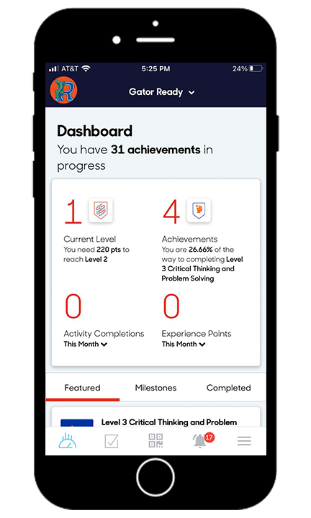
Dashboard and Mobile Scorecard

Slide 17
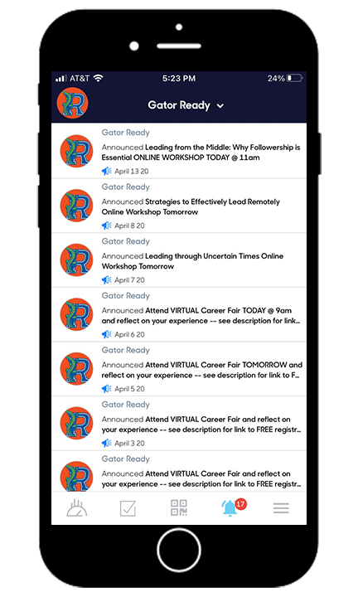
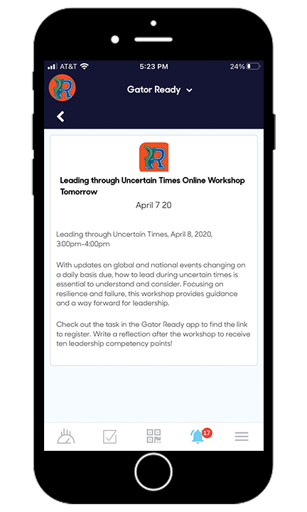
Push Notifications

Slide 18
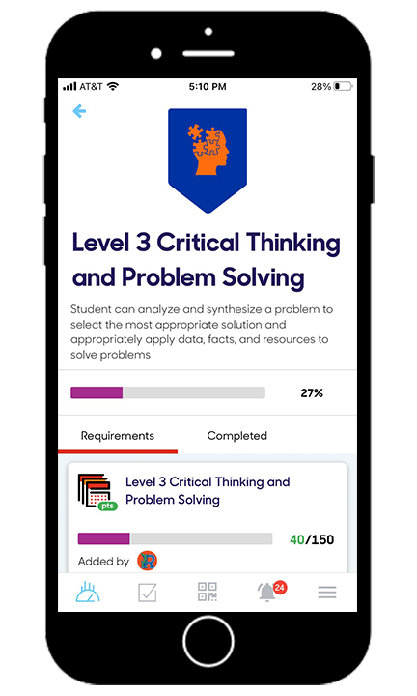
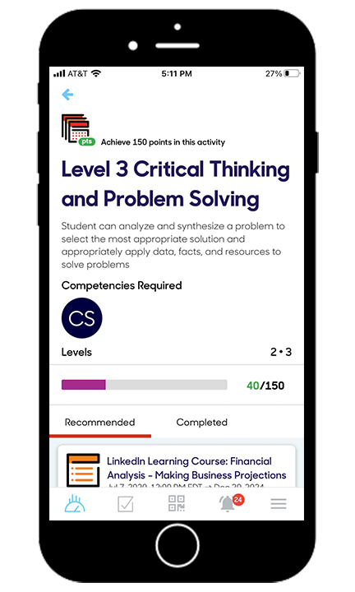
Achievements

Slide 19
Gator Ready Digital Badge Branding

Slide 20
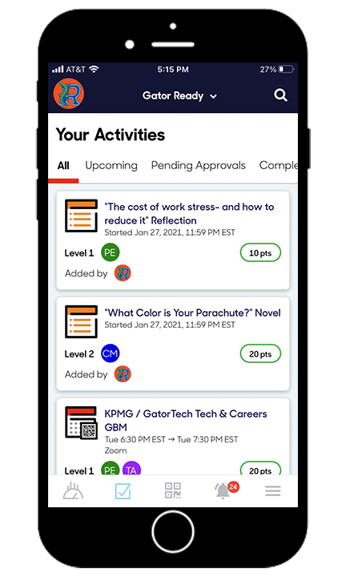
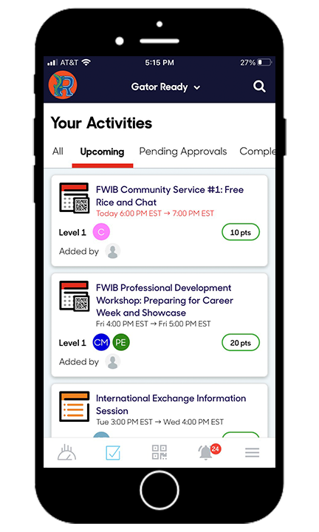
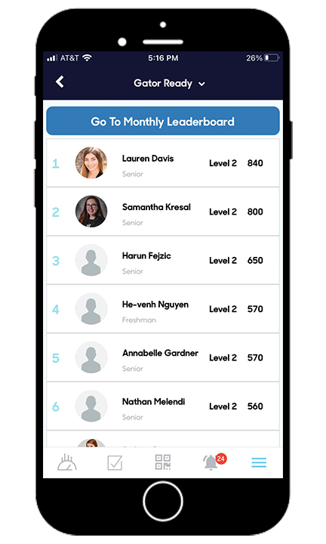
Activities, Upcoming Events, Leaderboard

Slide 21
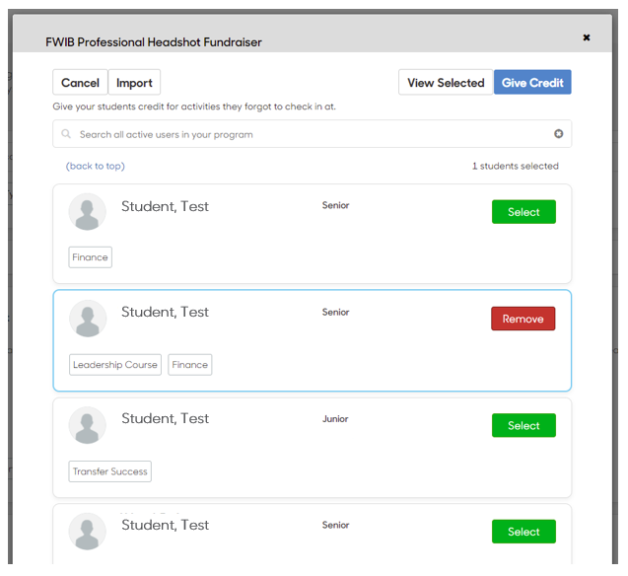
Give Credit Capabilities

Slide 22
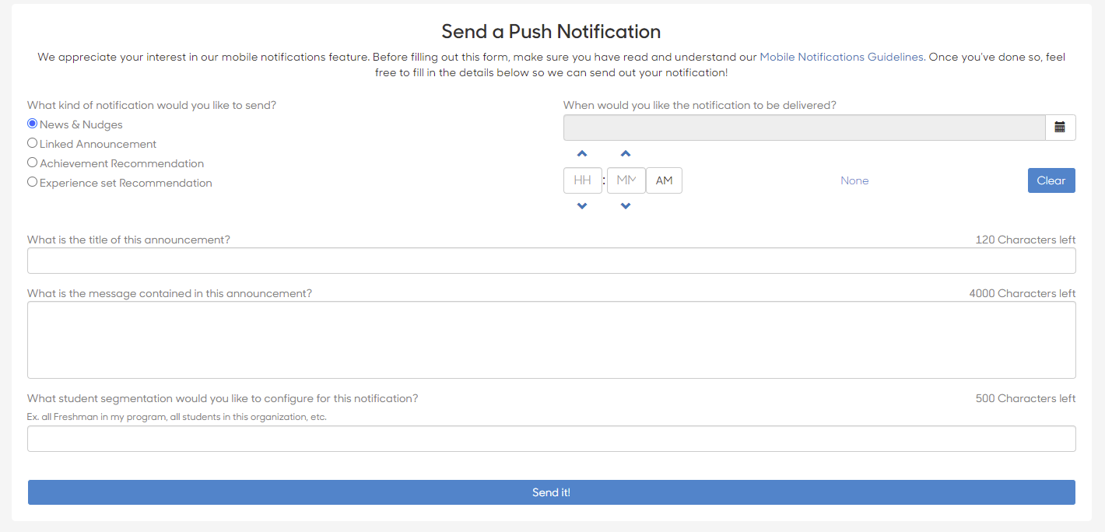
Student Communication Capabilities

Slide 23
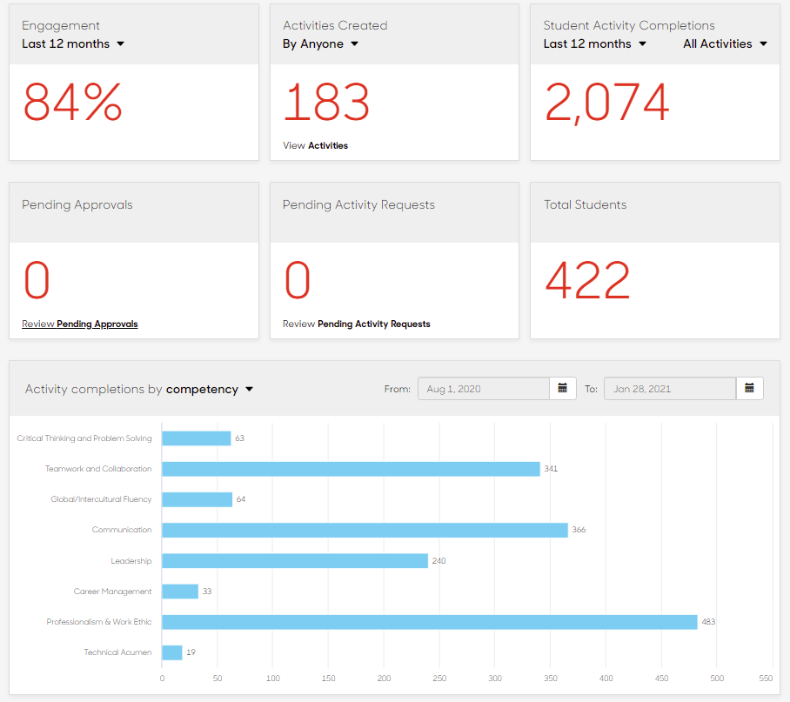
Real Time Engagement Analytics

Slide 24
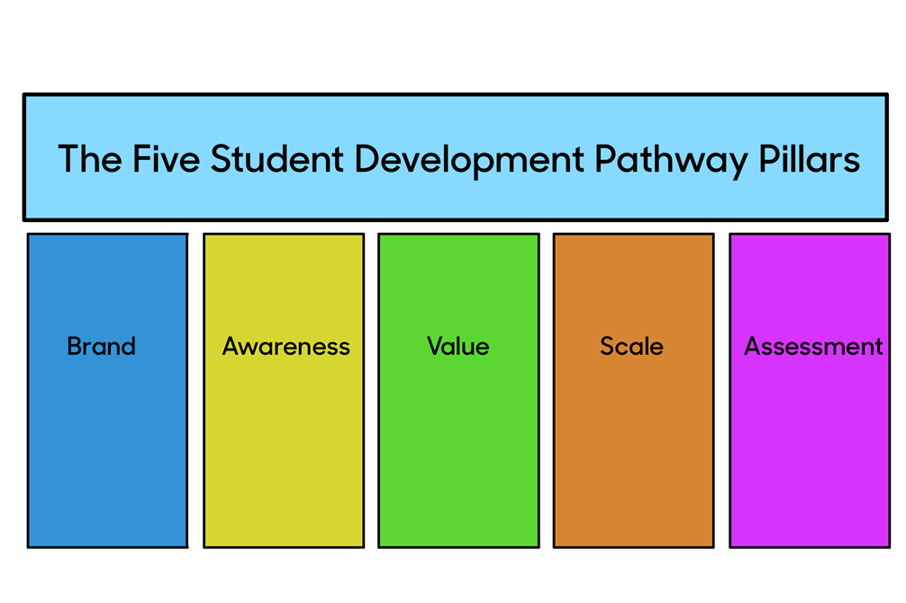
Strategies for Successful Student Adoption
Start with a smaller planning team
Create a brand that is personalized to your school
Develop a comprehensive awareness strategy
Student value proposition: Engagement = Development
Take advantage of momentum. Be ready to scale
Created Hype videos for your program
Create walk through video for student usage
Get buy-in for a faculty support pilot
Experience-based incentives are more effective
Create a student ambassador program
Employer buy-in can sell the value for you
Give students options to earn progress. Don't be too prescriptive.
Feature engaged students in your periodic newsletter
Team-based competitions add a social component

Slide 25
Future Plans for Gator Ready
Tie Competencies into course work
Mapping competencies to employment opportunities
Using Gator Ready scores as gateway to career events
Program evaluation and assessment using Gator Ready data

Slide 26
POLL
What would you like next from Suitable?

Slide 27
Questions?

