Slide 1
There’s an App for That:
Tracking MBA Student Engagement and Leadership Development
03.18.2021

Slide 2
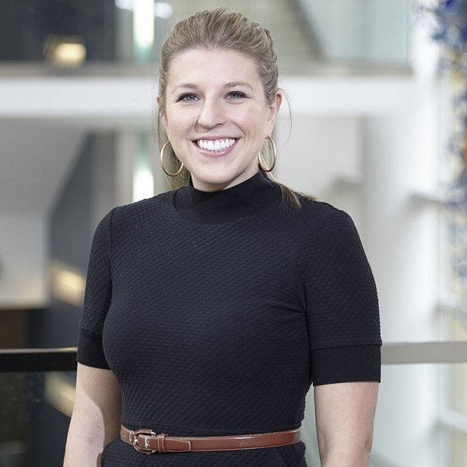
Introductions
Catie Mullan
Academic Program Manager
Full-time MBA
Scheller College of Business
Georgia Tech
Julia Snell
Associate Director
Full-time MBA
Scheller College of Business
Georgia Tech
Sean Carson
Vice President
University Partnerships
Suitable

Slide 3
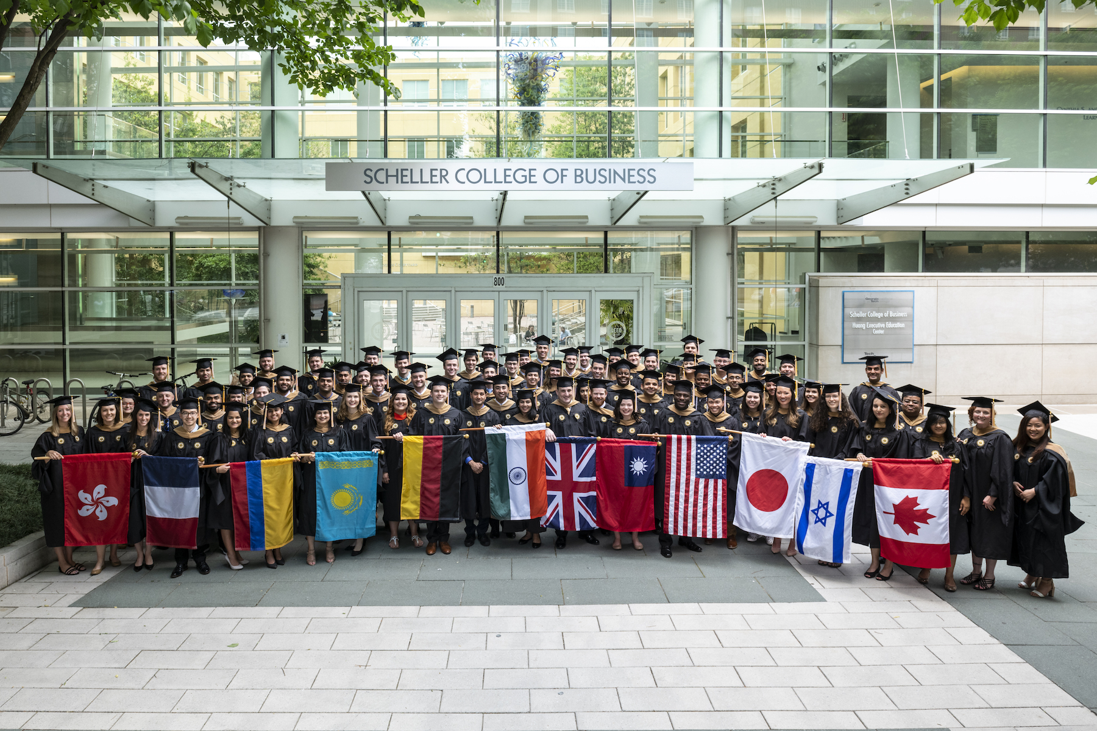
Scheller College of Business MBA Program
Financial Times #2 ranking – Career Services
U.S. News & World Report #3 ranking – MBA in Business Analytics
Bloomberg Businessweek #3 ranking – Best MBA Graduates for Innovation and Creativity
The Economist #5 ranking – Full-time MBA
Forbes #9 ranking – Full-time MBA Among Public Institutions

Slide 4
Agenda
Life before CHARGE
Why make a change?
Why technology was necessary
Bridging student engagement and leadership development
Identifying Leadership Competencies
How CHARGE impacted Scheller
CHARGE app tour
FREE GIVEAWAY – Branded MBA app
Strategies for successful student adoption
Future Plans for CHARGE
Questions

Slide 5
Learning outcomes for this session
Have tangible solutions to incorporate technology within your leadership development program
Implement a competency based framework for your leadership development program
Consider a more intentional approach to your MBA out-of-class experience

Slide 6
Life at Scheller before CHARGE
Scattered approach to Leadership Development
The only formalized leadership opportunities were courses: Ethics, Leading People and Organizations, and a Leadership Development Workshop
Students felt ill prepared on leadership skills

Slide 7
POLL
How is your business school using technology to track student engagement and leadership development?

Slide 8
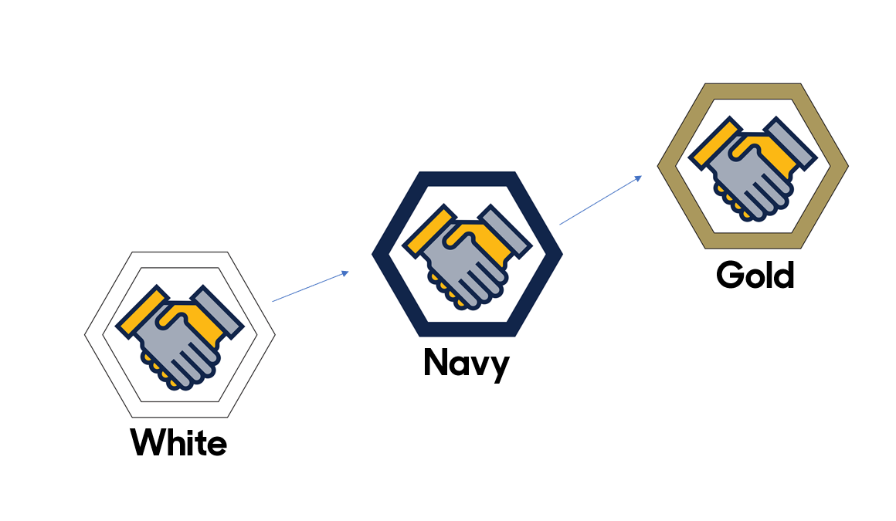
Why make a change?
Current leadership programming was not comparable to peers
Employers' feedback in wanting soft skills in addition to hard technical skills
Responding to students' request for more leadership development
Help students create a personal leadership brand
Brand and organize current Scheller offerings
Package the content in an easily digestible way

Slide 9
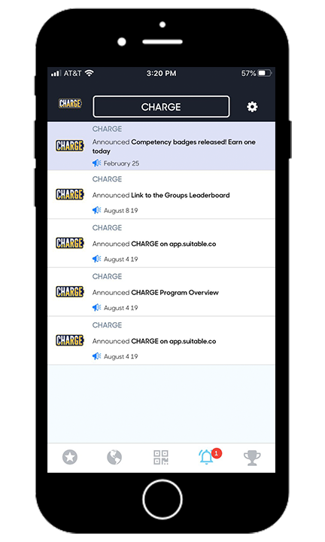
Why was technology necessary?
Mobile phone usage is prevalent
Needed a way to track the student lifecycle
Program assessment
Communication with students
In need of scalable tracking
Didn’t want to reinvent the wheel

Slide 10
POLL
How is your business school using competencies to unify programming?

Slide 11
Bridging Student Engagement and Leadership Development
STUDENT
ENGAGEMENT
LEADERSHIP
DEVELOPMENT

Slide 12
Identifying Leadership Competencies
Evaluated existing leadership activities
Held focus groups with students to talk through the competencies and definitions
Partnered with Career Services
Added “Engagement” for non-leadership activities i.e. Crawfish Boil

Slide 13
How CHARGE impacted Scheller
86% Engagement Rate
3,681 Completed Activities
Average of 39 activities completed per student
83 students earned white level in at least one competency
Focused more on team-based vs. individual competition
Incentives to engage with peers i.e. Coffee, mentorship, events, etc.
Peer to peer Kudos was effective
Badges recognized milestones and achievements i.e. white, navy, gold
Made the experience more fun for our students
Created a habit of active engagement on their mobile phones
Expanded program to Evening MBA Program

Slide 14
Tour of CHARGE

Slide 15
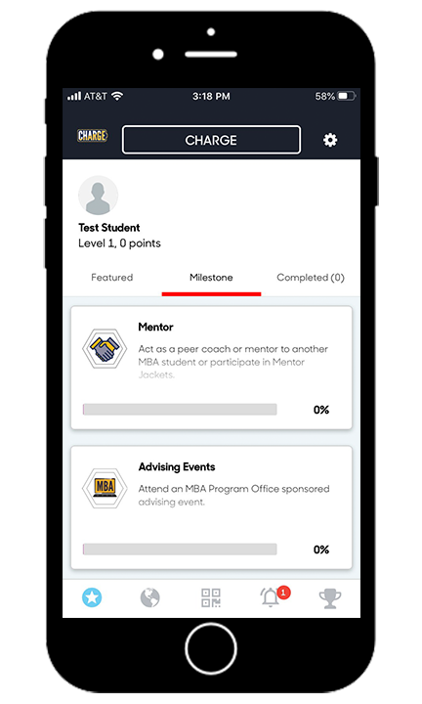
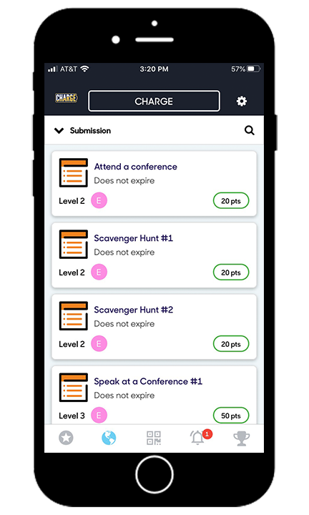
Mobile Scorecard, Push Notifications and Task Activities

Slide 16
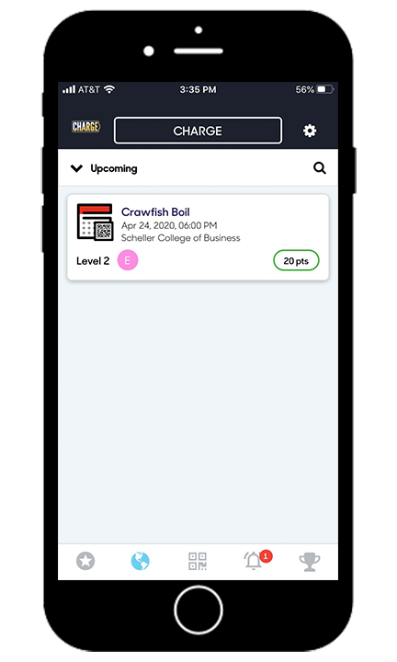
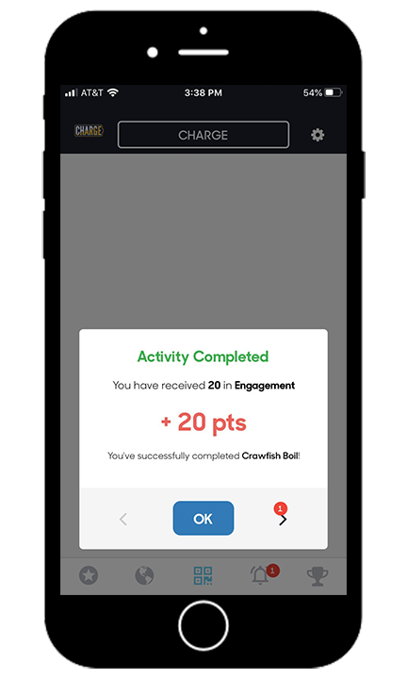
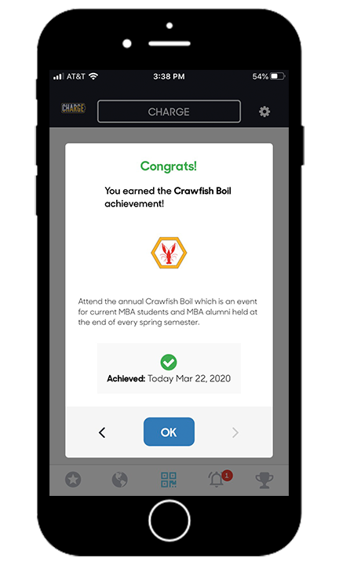
Upcoming Events, Mobile Scanner and Automated Awarding

Slide 17
Students are encouraged to Go for Gold

Slide 18
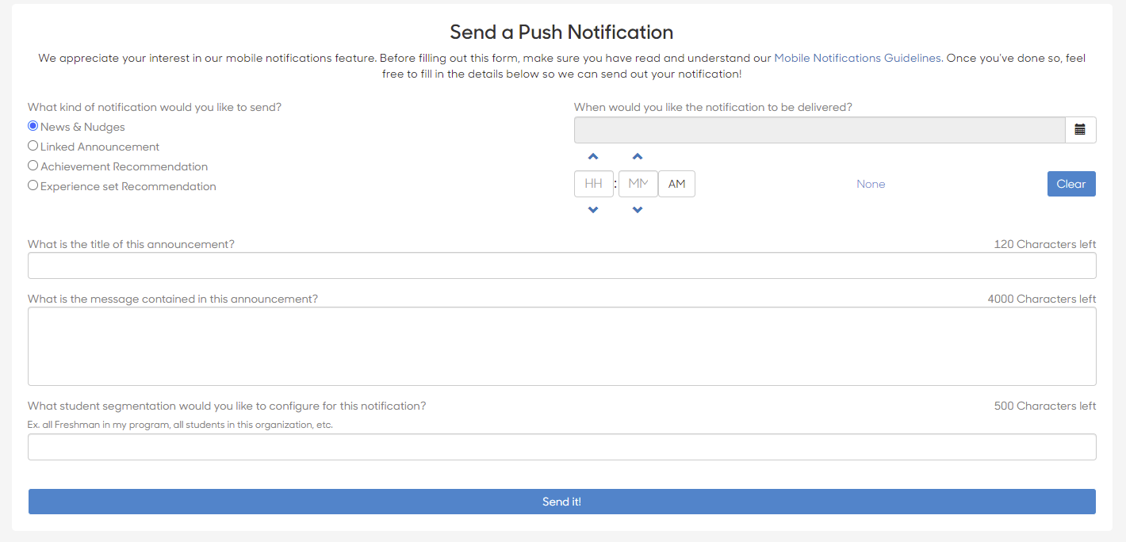
Student Communication Capabilities

Slide 19
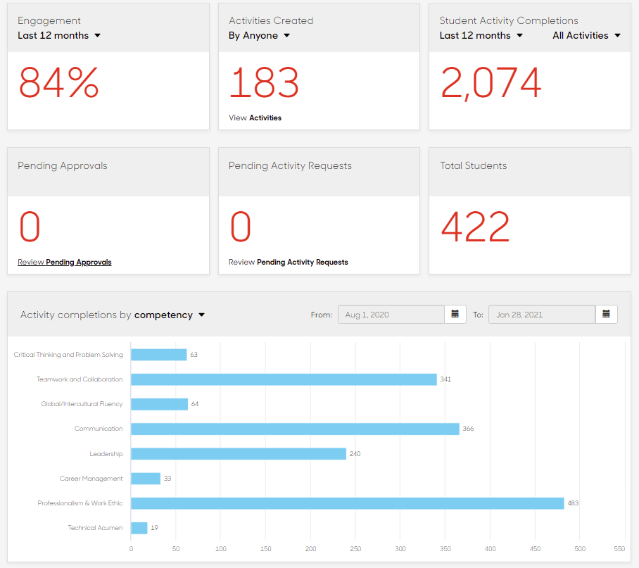
Real Time Engagement Analytics

Slide 20
FREE GIVEAWAY – Branded MBA app
Comment “App” in the chat
for a branded MBA app to test

Slide 21
Strategies for Successful Student Adoption
Start with a smaller planning team
Create a brand that is personalized to your school
Develop a comprehensive awareness strategy
Student value proposition: Engagement = Development
Take advantage of momentum. Be ready to scale
Created Hype videos for your program
Create walk through video for student usage
Get buy-in for a faculty support pilot
Experience-based incentives are more effective
Create a student ambassador program
Employer buy-in can sell the value for you
Give students options to earn progress. Don't be too prescriptive.
Feature engaged students in your periodic newsletter
Team-based competitions add a social component

Slide 22
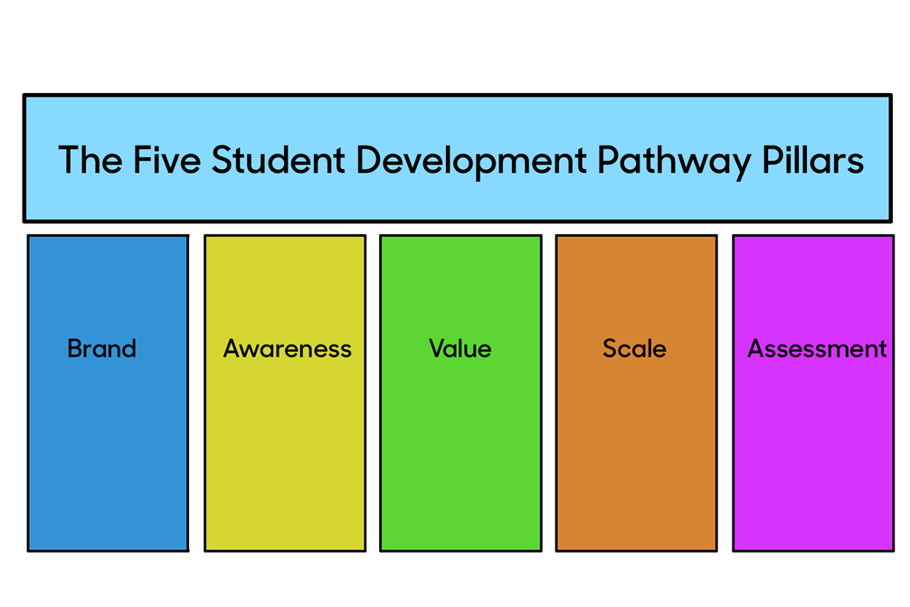
The five pillars of student development

Slide 23
POLL
What would you like next from Suitable?

Slide 24
Questions?

